Slide 1
Smart Street Light management System
N Sai rahul (CB.EN.U4CSE15236)
M RAJA (CB.EN.U4CSE15233)
R SAKETH (CB.EN.U4CSE15243)
CH RATAN SAI (CB.EN.U4CSE15208)

Slide 2
introduction
A lot of energy is wasted in providing lighting for streets
Nearly 38% of total electric bill will be for lighting up streets
Not all streets are used frequently by people
Light glow in those parts with out any use
This also reduces the life time of bulbs

Slide 3
Problem statement
Our aim is to achieve power saving in the case of street light by creating a model based on IOT that senses the light in surroundings and on the street light if the light intensity is low

Slide 4
Challenges
Loss of net connectivity
Obstacle encountered in front of IR sensor
Obstacle covering LDR sensor
Defective in equipment’s
Delays in analysing readings
Light disturbance

Slide 5
Solution
We want to design an IOT application that senses the intensity of light, if intensity goes down by threshold value it sends signal and switch on the street lights, and these lights glow at half the intensity, and IR sensors are placed on the sides of road, these are used to sense the motion, if IR sensor senses motion it sends a signal so that street lights glow at full intensity. If the light intensity increases more than threshold then system sends signal which turns off the lights

Slide 6
Working
The system uses LDR sensor to sense the intensity of light present
If the light goes down below the threshold then it will glow the street lights at 50% of its intensity
IR sensor senses the motion
If it detects motion it sends a signal so that the system will make lights glow at full intensity

Slide 7
Conditions
When light is present in ambiance and no vehicle is present :-
When light is present in ambiance the LDR sensor senses the light and sends the signal to ARDUNIO board that so that no lights will be glowing
When light is present in ambiance and vehicle is in motion :-
When vehicle passes by IR sensor it sends the signals to ARDUNIO board but the LDR sensor detects light so it sends signals so that the lights will not glow
When light is not present and vehicle is not moving :-
When light was not present LDR sensor sends signals so that the lights will glow at some intensity not full intensity
When light is not present and vehicle is not moving :-
When light was not present LDR sensor sends signals so that the lights will glow at some intensity not full intensity, but when IR sensor detects movement of vehicle it will send signal to ARDUNIO board so that lights will glow at full intensity

Slide 8
Components used
ARDUINO UNO
10 mm LED’s
LDR SENSOR
IR SENSORS
JUMBO WIRES
BREAD BORD
CLOUD : THINK SPEAK
DATA REPRESENTATION : ANROID APP

Slide 9
TECHNOLOGIES AND PROTOCOLS
Technologies:
Cloud : thing speak
Arduino
Protocols:
TCP
Wi-Fi
HTTP

Slide 10
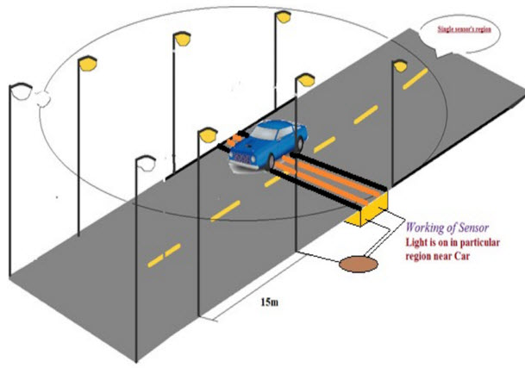

Slide 11
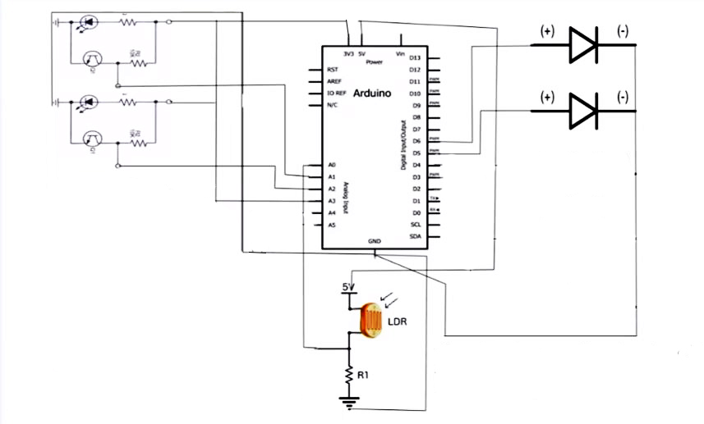
CIRCUIT DIAGRAM

Slide 12
END USER BENEFITS
Reduction of human interference in controlling the operation of street lights
Can monitor and analyse how much time the streetlights are on
traffic in that road can be calculated
Saving of electricity

Slide 13
Future enhancement
Messages and emails
Live feed to subscribers
Notifications
Alarms

Slide 14
Refrences
https://thingspeak.com
https://www.circuito.io/
https://www.circuitlab.com/editor/#?id=6t78uk
https://ubidots.com/
https://io.adafruit.com/
https://github.com/esp8266/Arduino/tree/master/libraries/ESP8266WiFi
https://www.arduino.cc/en/main/documentation

Slide 15
Thank you

